Slide 1
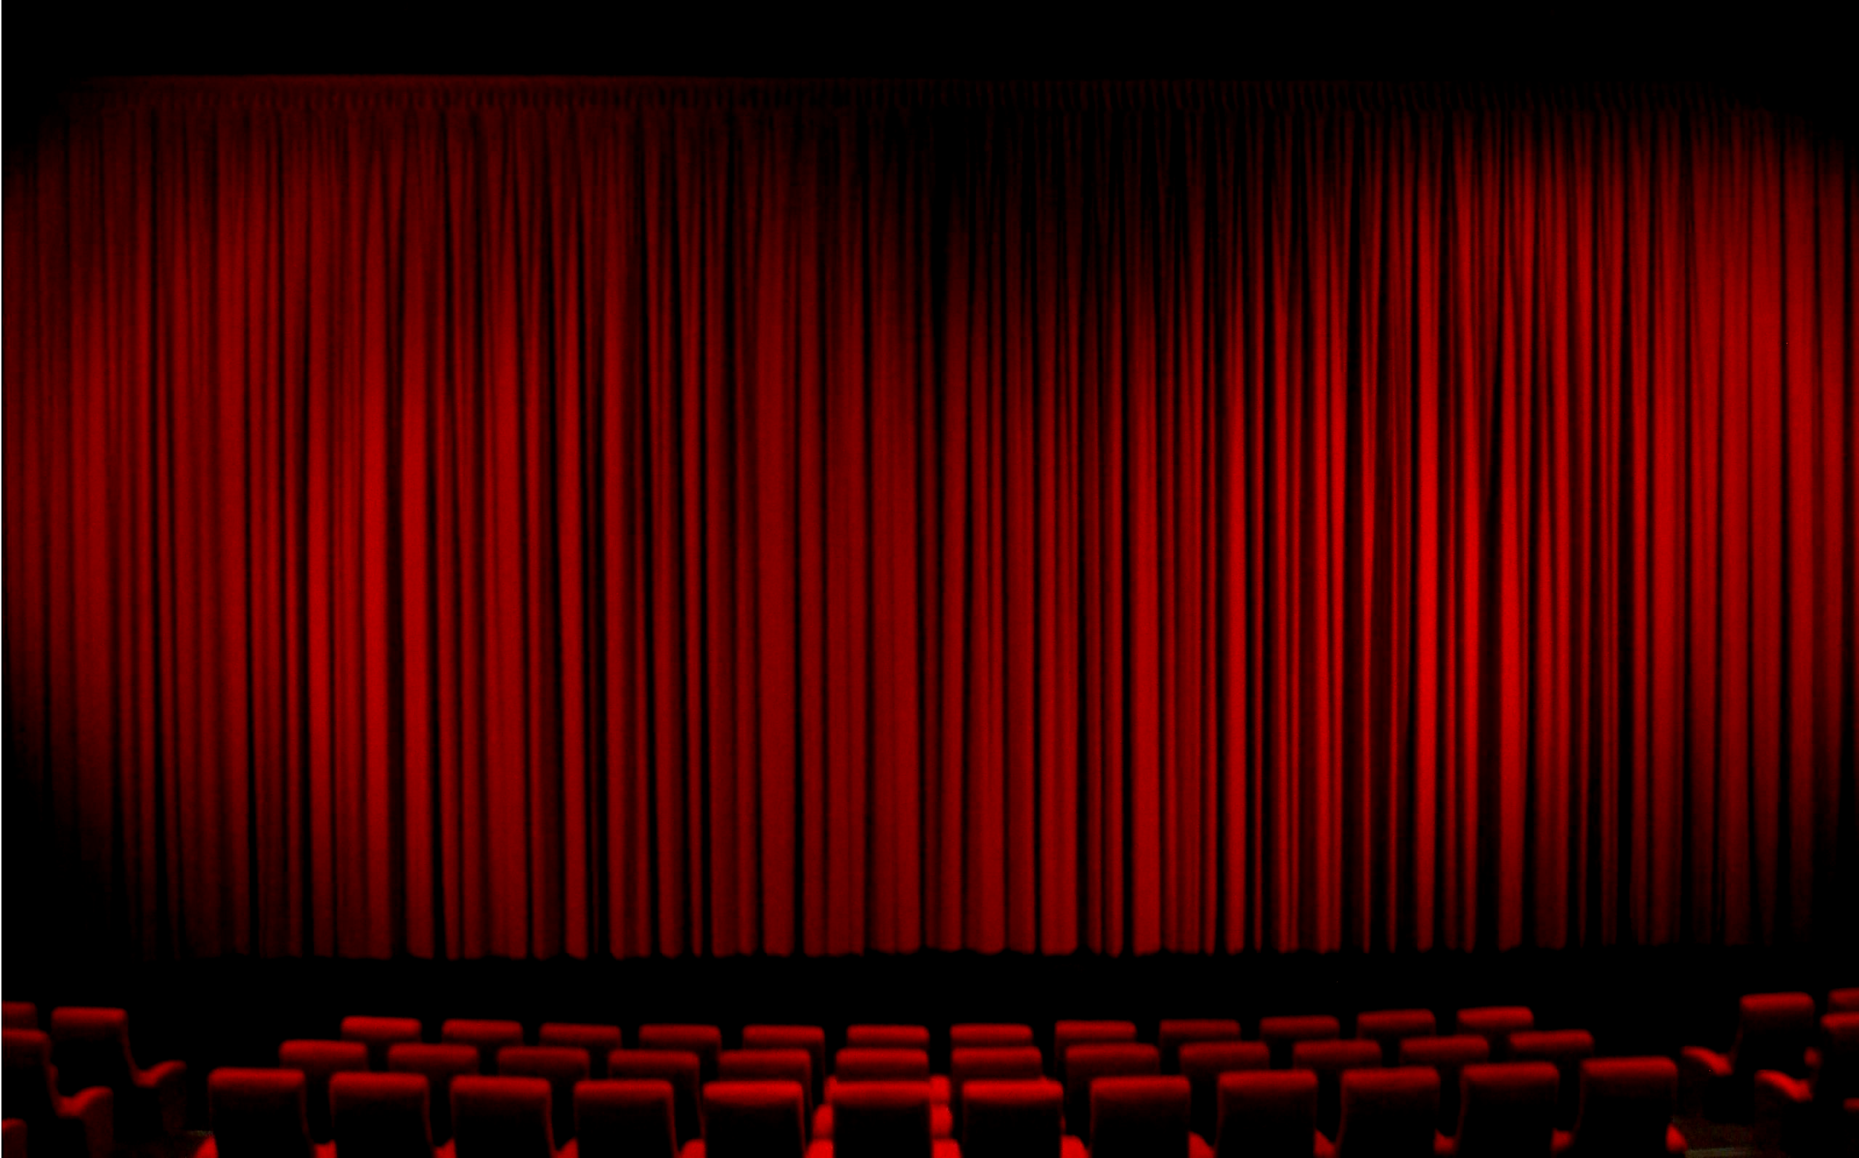
Movie Round
Last Lines

Slide 2
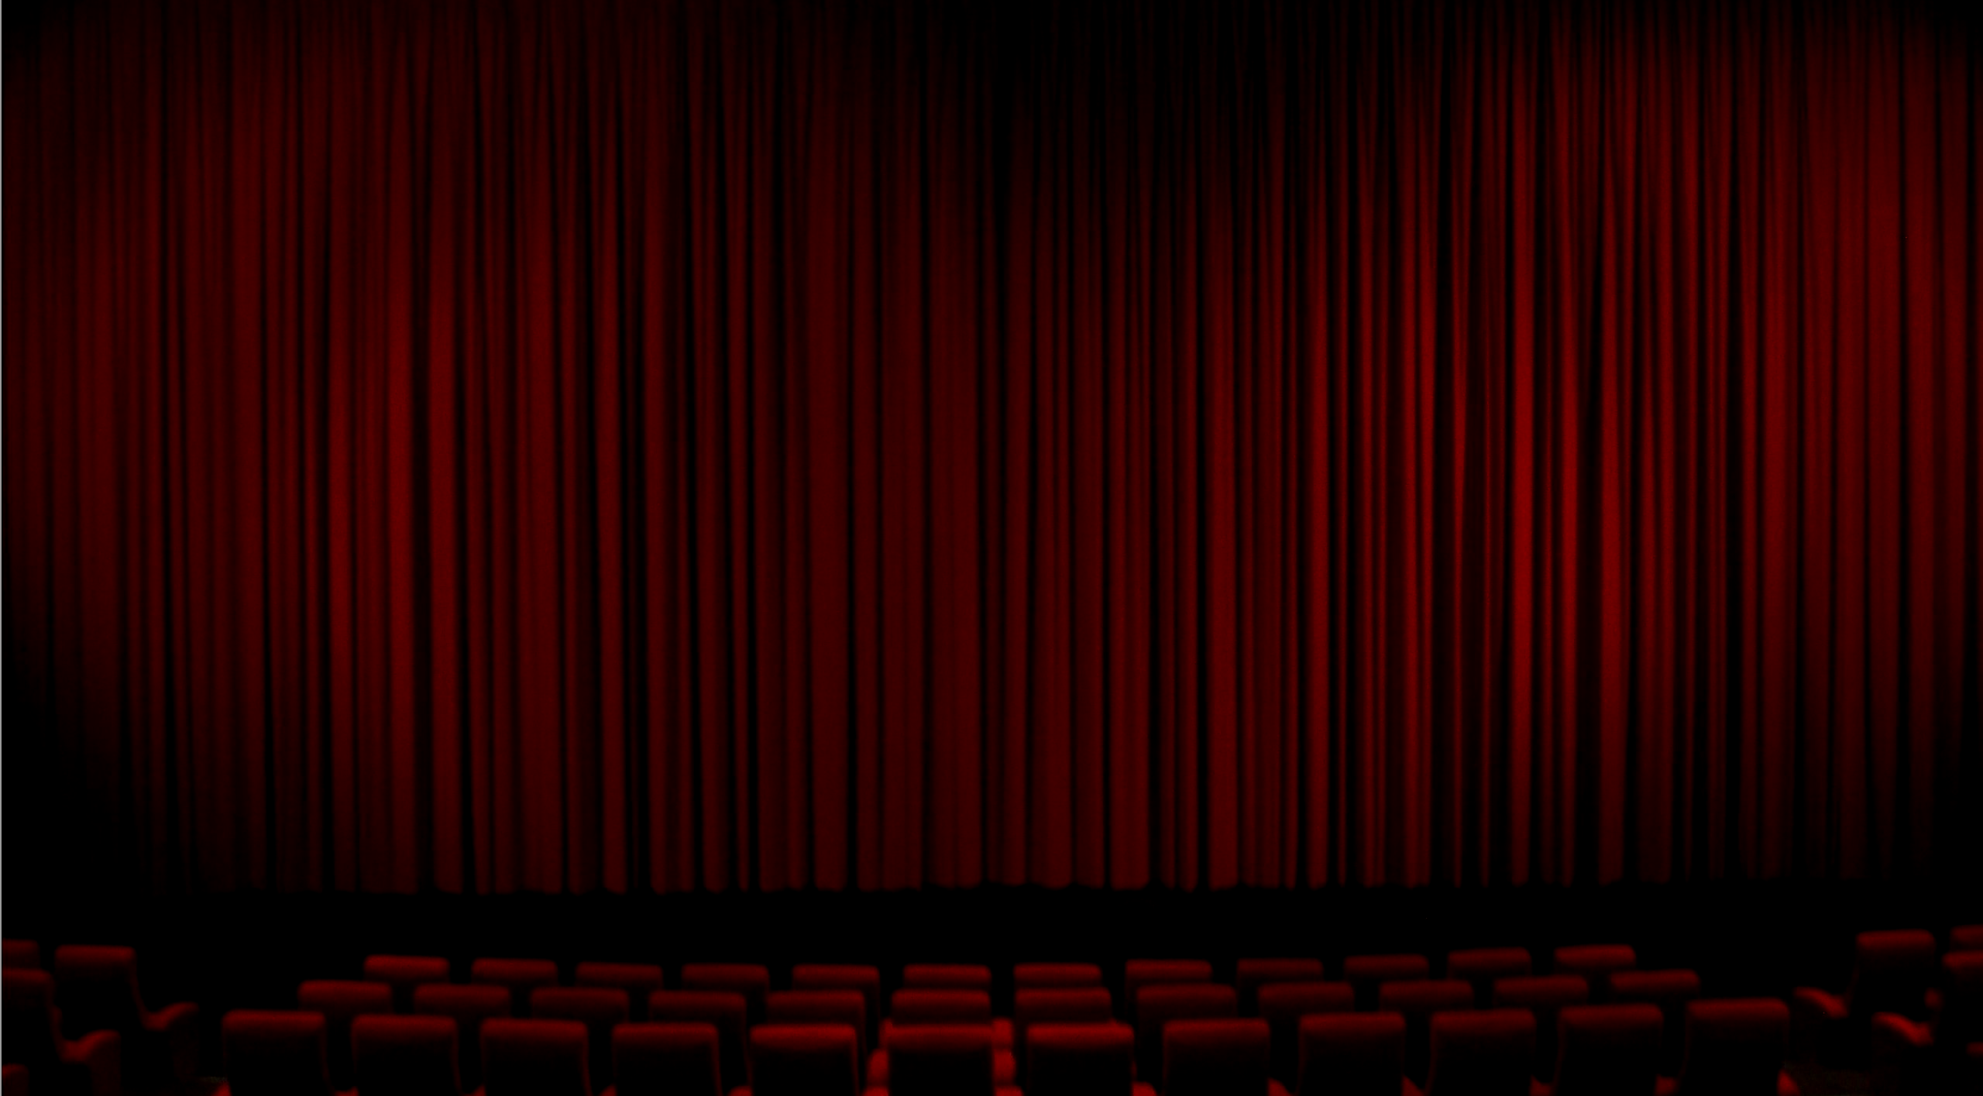
1)
“This is Ripley, last survivor of the Nostromo, signing off.”

Slide 3
2)
“Louis, I think this is the beginning of a beautiful friendship.”

Slide 4
3)
“Roads? Where we’re going we don’t need roads.”

Slide 5
4)
“After all, tomorrow is another day.”

Slide 6
5)
“I’m not even gonna swat that fly. I hope they are watching. They’ll see. They’ll see and they’ll know and they’ll say, ‘Why, she wouldn’t even harm a fly.’”

Slide 7
6)
“I used to hate the water.”
“I can’t imagine why.”

Slide 8
7)
“I do wish we could chat longer, but I’m having an old friend for dinner.”

Slide 9
8)
“I’ll be right here.”

Slide 10
9)
“Oh, Auntie Em, there’s no place like home.”

Slide 11
10)
“Oh, no. It wasn’t the airplanes. It was Beauty killed the Beast.”

Slide 12
11)
“Well, nobody’s perfect.”

Slide 13
12)
“No. No, I don’t think I will.”

Slide 14
13)
“You maniacs! You blew it up. Ah, damn you! God damn you all to hell!”

Slide 15
14)
“But which was destroyed? The master or the apprentice?”

Slide 16
15)
“Oh good. For a moment there I thought we were in trouble.”

Slide 17
16)
“Where we go from there is a choice I leave to you.”

Slide 18
17)
“Alright, Mr DeMille, I’m ready for my closeup.”

Slide 19
18)
“I never had any friends later on like the ones I had when I was twelve. Jesus, does anyone?”

Slide 20
19)
“They say they’re gonna repeal Prohibition. What will you do then?”
“I think I’ll have a drink.”

Slide 21
20)
“That’ll do pig. That’ll do.”

Slide 22
Movie Round
Answers

Slide 23
1)
“This is Ripley, last survivor of the Nostromo, signing off.”

Slide 24
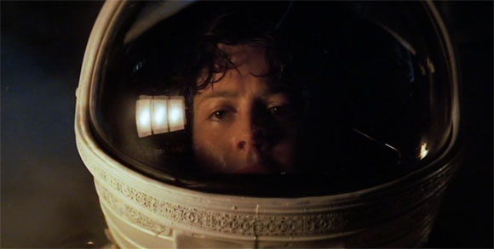
1)
Alien

Slide 25
2)
“Louis, I think this is the beginning of a beautiful friendship.”

Slide 26
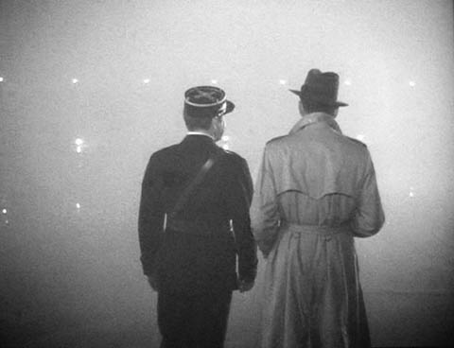
2)
Casablanca

Slide 27
3)
“Roads? Where we’re going we don’t need roads.”

Slide 28
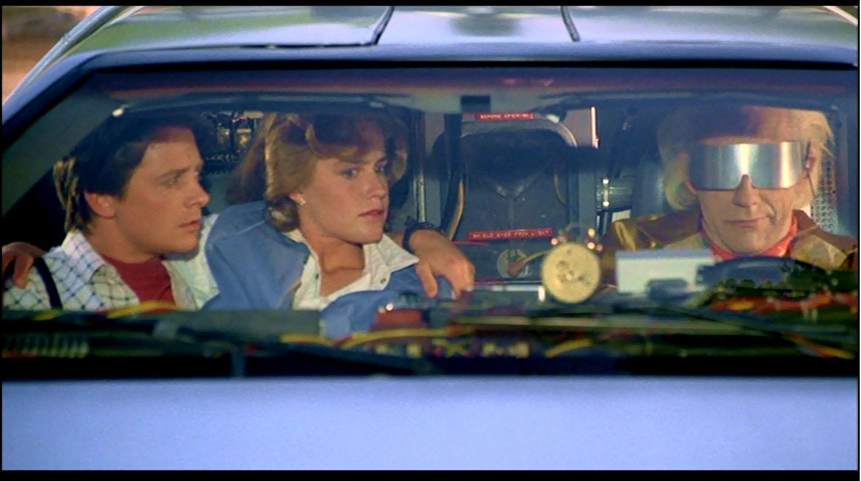
3)
Back To The Future

Slide 29
4)
“After all, tomorrow is another day.”

Slide 30
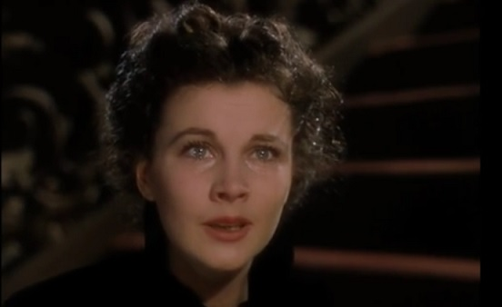
4)
Gone With The Wind

Slide 31
5)
“I’m not even gonna swat that fly. I hope they are watching. They’ll see. They’ll see and they’ll know and they’ll say, ‘Why, she wouldn’t even harm a fly.’”

Slide 32
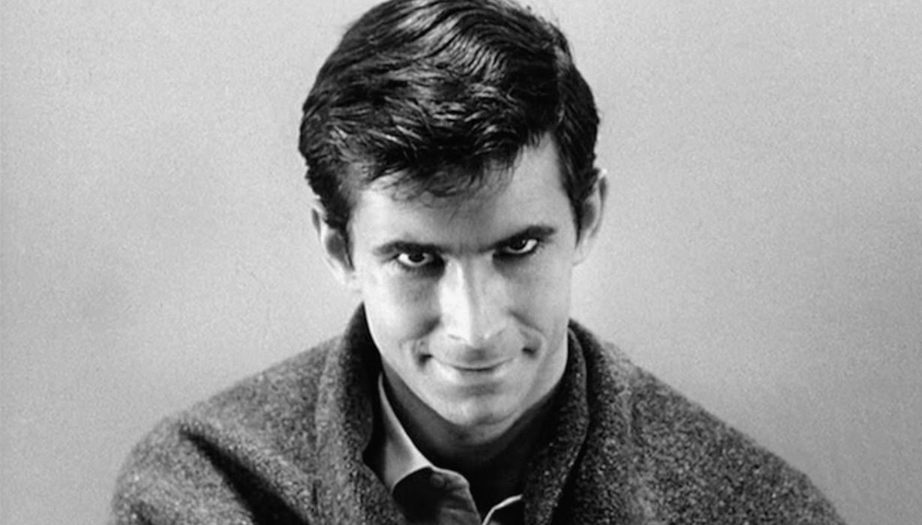
5)
Psycho

Slide 33
6)
“I used to hate the water.”
“I can’t imagine why.”

Slide 34
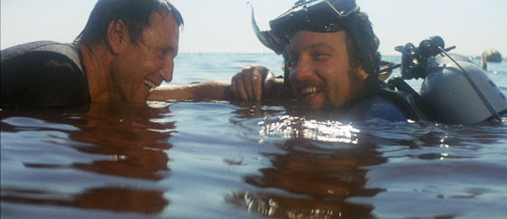
6)
Jaws

Slide 35
7)
“I do wish we could chat longer, but I’m having an old friend for dinner.”

Slide 36
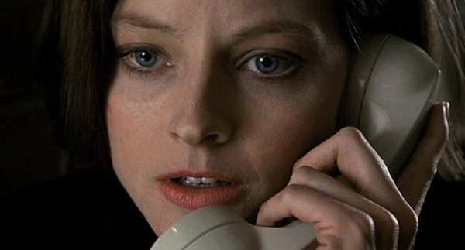
7)
The Silence Of The Lambs

Slide 37
8)
“I’ll be right here.”

Slide 38
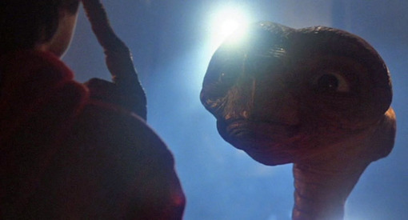
8)
E.T.

Slide 39
9)
“Oh, Auntie Em, there’s no place like home.”

Slide 40
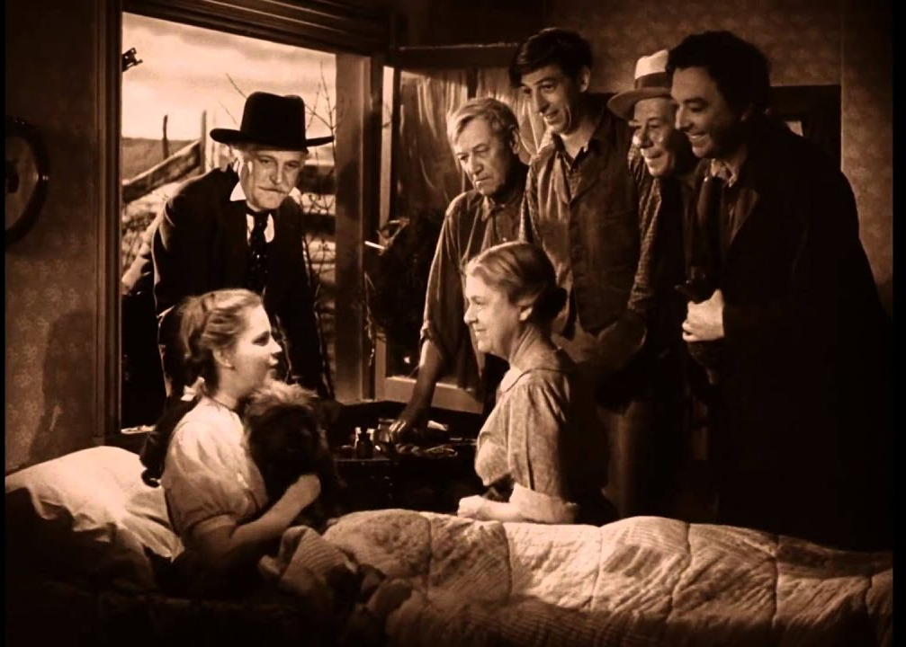
9)
The Wizard of Oz

Slide 41
10)
“Oh, no. It wasn’t the airplanes. It was Beauty killed the Beast.”

Slide 42
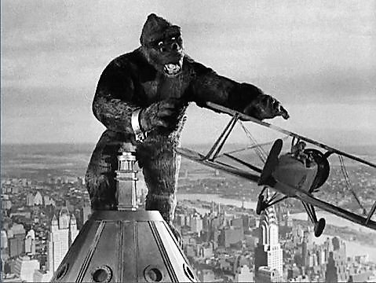
10)
King Kong, 1933

Slide 43
11)
“Well, nobody’s perfect.”

Slide 44
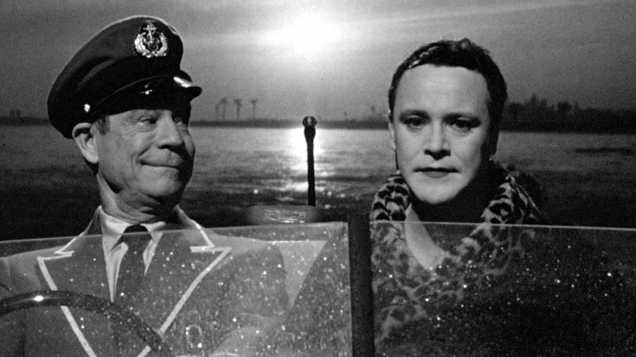
11)
Some Like It Hot

Slide 45
12)
“No. No, I don’t think I will.”

Slide 46
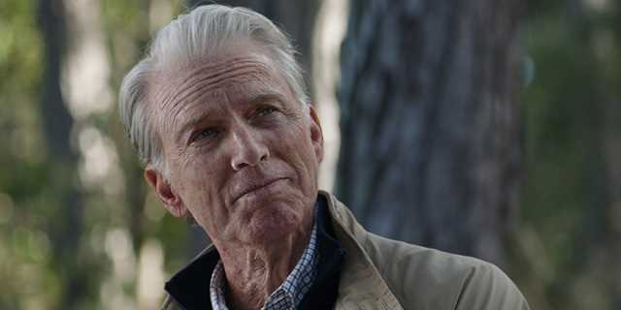
12)
Avengers: Endgame

Slide 47
13)
“You maniacs! You blew it up. Ah, damn you! God damn you all to hell!”

Slide 48
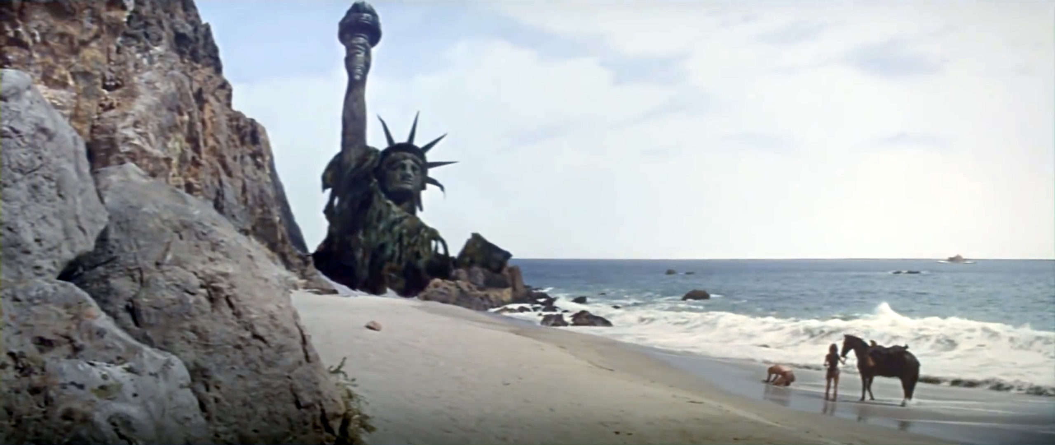
13)
Planet of the Apes, 1968

Slide 49
14)
“But which was destroyed? The master or the apprentice?”

Slide 50
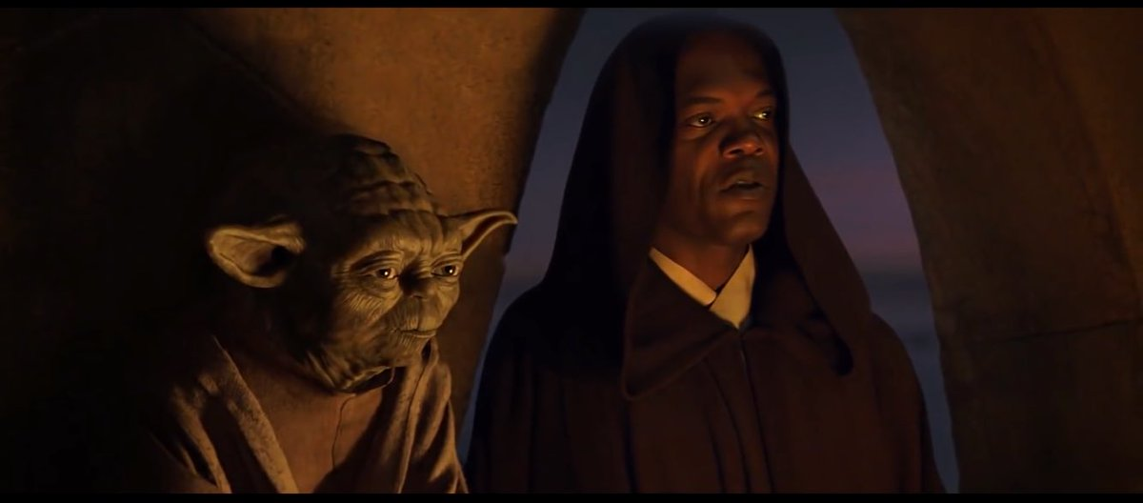
14)
Star Wars: Episode I - The Phantom Menace

Slide 51
15)
“Oh good. For a moment there I thought we were in trouble.”

Slide 52
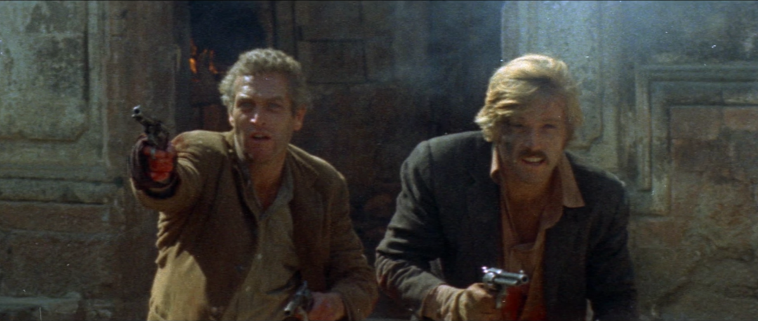
15)
Butch Cassidy and the Sundance Kid

Slide 53
16)
“Where we go from there is a choice I leave to you.”

Slide 54
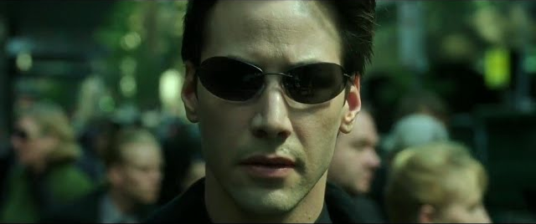
16)
The Matrix

Slide 55
17)
“Alright, Mr DeMille, I’m ready for my closeup.”

Slide 56
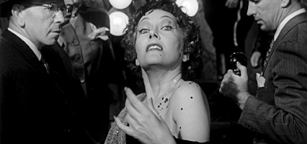
17)
Sunset Boulevard

Slide 57
18)
“I never had any friends later on like the ones I had when I was twelve. Jesus, does anyone?”

Slide 58
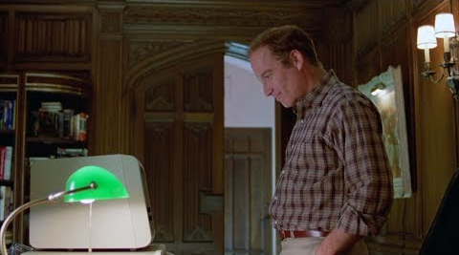
18)
Stand By Me

Slide 59
19)
“They say they’re gonna repeal Prohibition. What will you do then?”
“I think I’ll have a drink.”

Slide 60
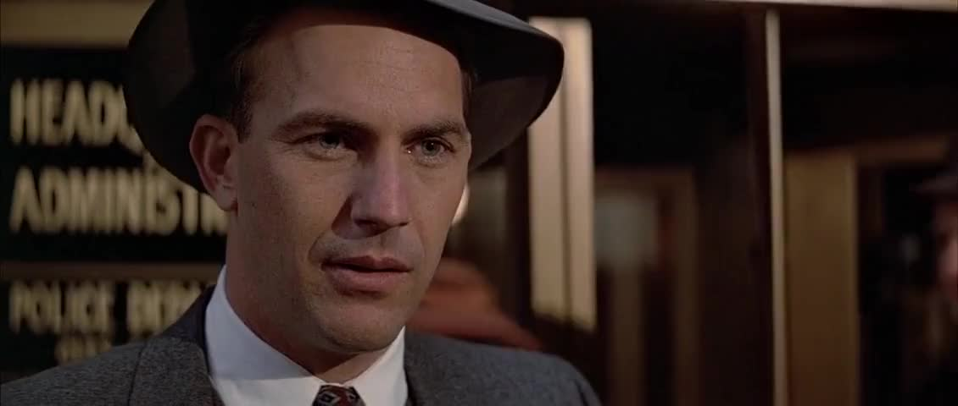
19)
The Untouchables

Slide 61
20)
“That’ll do pig. That’ll do.”

Slide 62
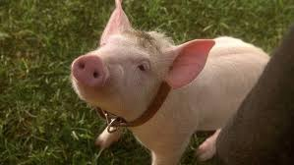
20)
Babe

